Slide 1
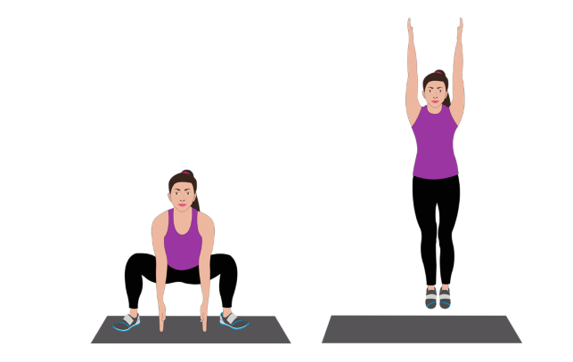
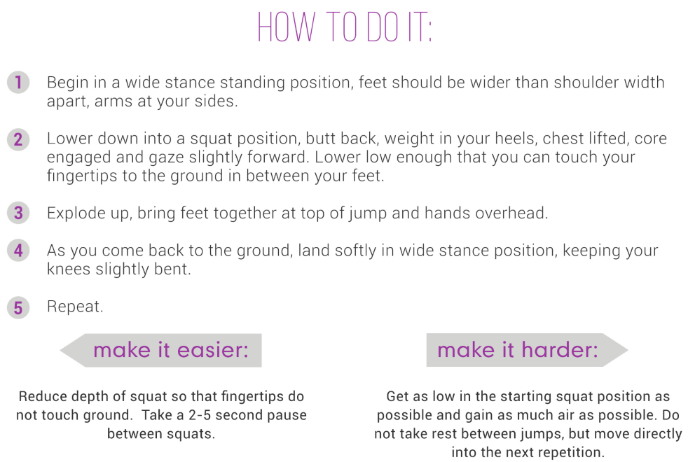
JACK IN THE BOXES
4 SETS OF 10

Slide 2
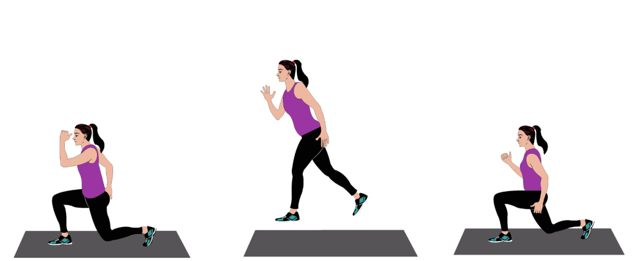
SPLIT JUMPS
4 SETS OF 10

Slide 3
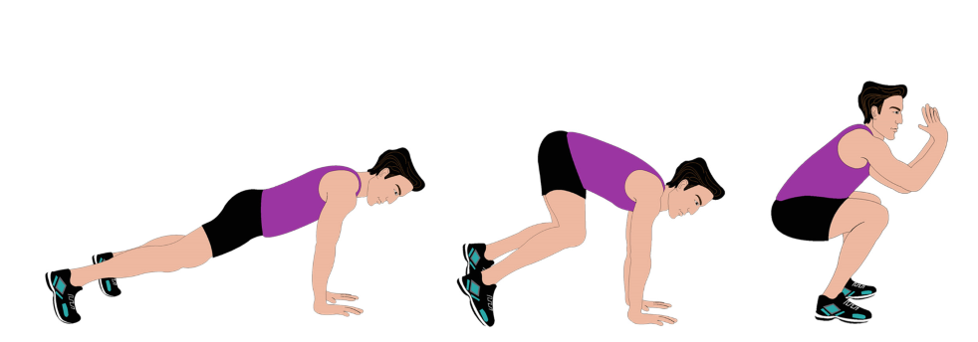
POP JACKS 4 SETS OF 10

Slide 4
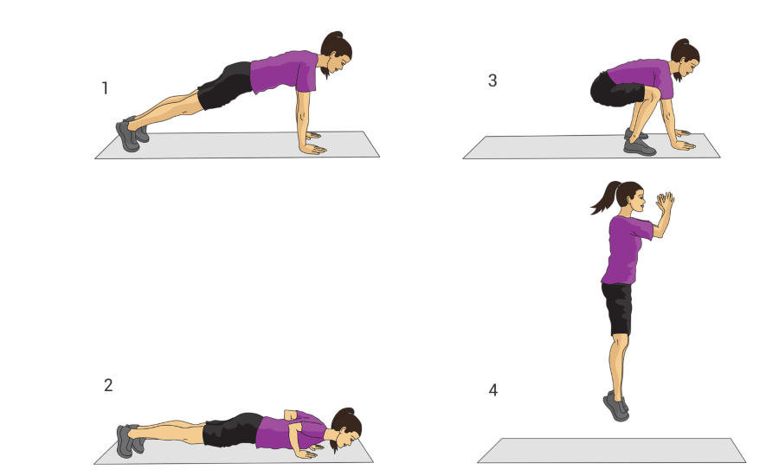
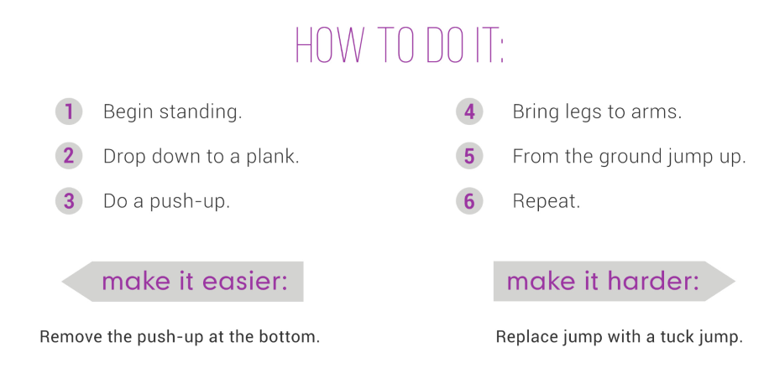
EXPLOSIVE BURPEES
4 SETS OF 10

Slide 5
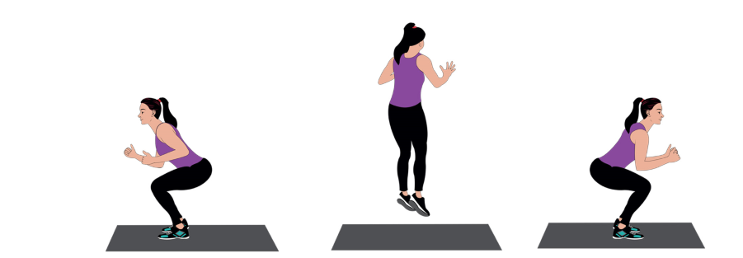
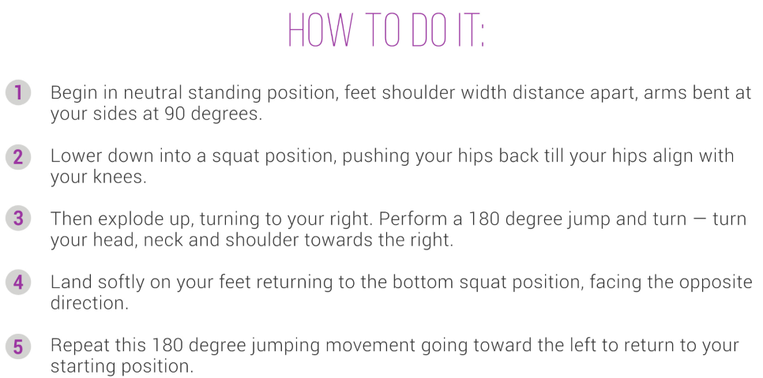
180 SPIDERMAN JUMPS
4 SETS OF 10

Slide 6
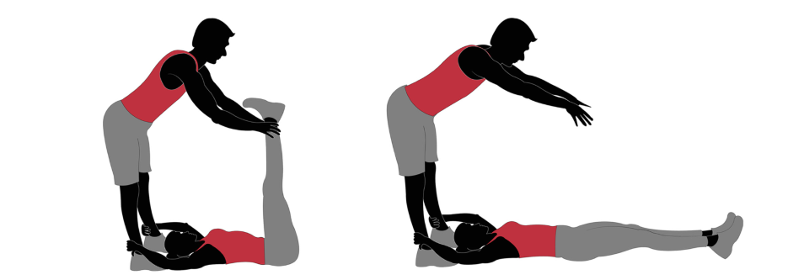
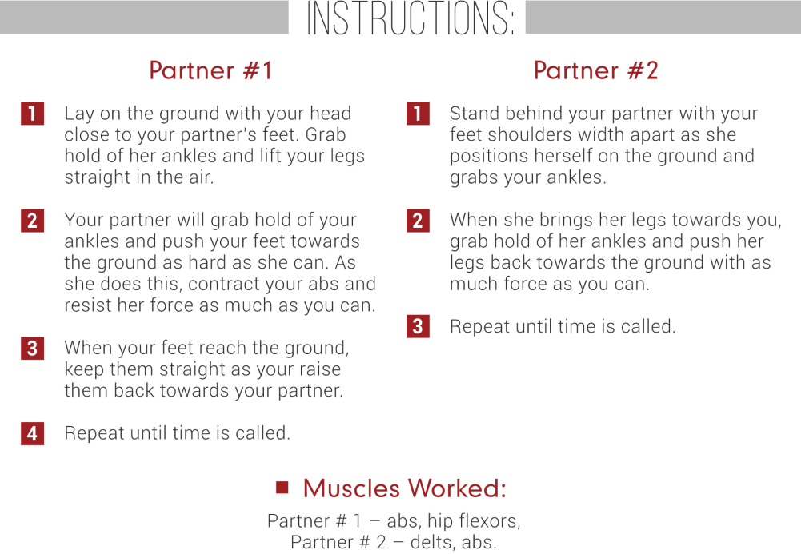
4 SETS OF 10

Slide 7
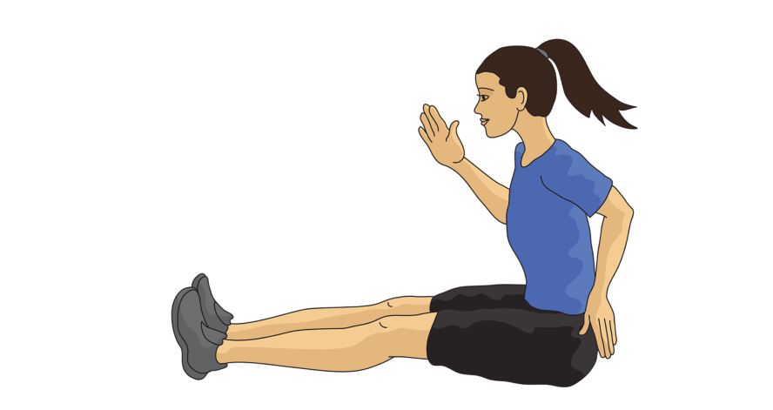
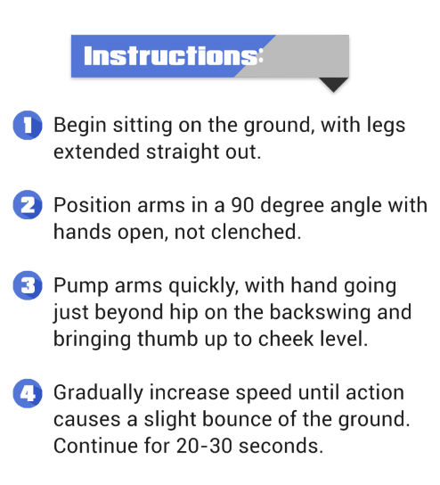
SEATED ARM SWINGS
4 SETS OF 10

